Slide 1
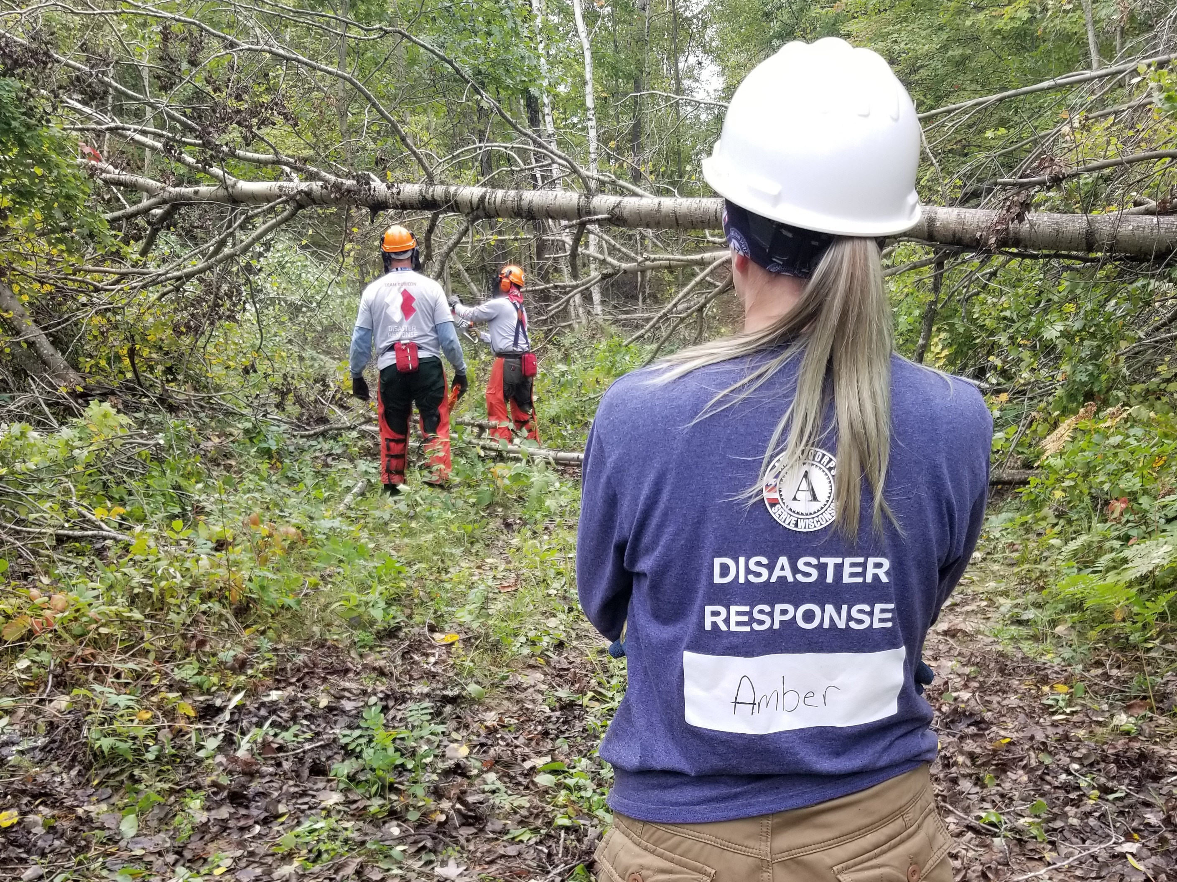
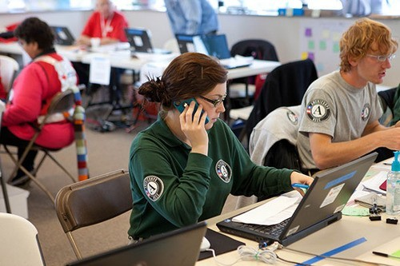
Welcome to the AmeriCorps Disaster Team!
Agenda for today:
Introductions
What to expect from the year
Overview of Disasters in Wisconsin
211 Wisconsin overview with Megan Kenney
Break out group activity
Next Steps!
Photo Credit: NCCC

Slide 2
Introductions
Everyone raise their hands—I’ll go through and call on you and then when you’re done you can lower your hand
Introductions:
Name
Program/Role
What are you most excited to learn about disaster response?
Choose one question to answer
What is something that always makes you smile?
Where is the coolest place you traveled?
Aside from necessities, what one thing could you not go a day without?
Photo Credit: NCCC

Slide 3
What to expect from the year!
Purpose: Give you the tools and knowledge you need to respond to disasters in Wisconsin!
Training commitments: monthly for about an hour (third Thursday of the month at 1pm)
Additional trainings: FEMA, 211, and DEI recording
Get connected with your local VOAD/COAD!
Reminder: Get supervisor approval first for time and training/travel reimbursement
Photo Credit: NCCC

Slide 4
Schedule
December: Overview of Incident Command, and how to take the FEMA trainings with Matt Brantner
January: DEI in Disasters (there’s a recorded training you’ll take ahead of the meeting, meeting time will be spent discussing the content of the training)
February: Agencies active in disasters
March: Sheltering with Jenny from the Red Cross
April: Volunteer Reception Centers with Gannon from WEM
May: In person training in Lacrosse!!
Photo Credit: NCCC

Slide 5
Disaster Response and Stress
From SAMSHA:
Responders are exposed to demanding and tense situations on a regular basis, with some of the most intense situations during and after disasters. Every disaster is different. Are many people affected? Is there a massive amount of destruction? Have many people died? Is the working environment stable? Are there enough resources to properly assist and care for the survivors? Are you or your family personally affected? All these questions and more play a role in the stress levels of responders.
Photo Credit: NCCC

Slide 6
Disaster Response and Stress
Responders can build their resilience by increasing awareness about risk factors and warning signs, talking with each other, and using healthy coping strategies.
As you go through trainings, be conscious of how you’re affected. Some of the topics can be heavy and triggering. Make sure to practice self care!
Take a walk after trainings, or develop other self care tactics
Talk to a friend, coworker, or supervisor
Photo Credit: NCCC

Slide 7
Disasters in Wisconsin
Question for the group: Does anyone know of/remember a disaster that has happened in Wisconsin?
Photo Credit: NCCC
Notes:
.

Slide 8
Disasters in Wisconsin
Floods: Floods in Wisconsin are a relatively common occurrence because of overflowing rivers or lakes and heavy surface run-off in flat areas. In 2017, 17 counties in southwest Wisconsin and 3 counties in southeast Wisconsin declared a state of emergency because of heavy rains and flooding. A big flood can cause massive water damage, stall and wash cars away, and create health hazards depending on the source of the water.
Tornados: Tornados are quite common in Wisconsin, especially in the southern part of the state. Tornados can cause damage to homes, crops and roads. In 1984 an F5 tornado blew through the town of Barneveld, killing 9 people.
Photo Credit: NCCC

Slide 9
Disasters in Wisconsin
Blizzards and Snowstorms: Blizzards, snowstorms, and ice storms can all do major damage to your roof, create dangerous roadways, and even increase the risk of carbon monoxide poisoning in your home or car. For folks in our communities who don’t have a home, snow and cold can cause dangerous exposure. For folks in our community whose electricity isn’t reliable, storms can cause cold, dangerous conditions.
Wildfires: Wildfires are a huge risk in Wisconsin, especially during the spring, where as the snow melts, leaves, pine needles, and other combustibles are left on the ground to dry. In 2005, a fire to burn grass became out of control, burning over 3100 acres in Big Flats (Adams County), and destroying 30 homes.
Photo Credit: NCCC

Slide 10
Disasters in Wisconsin
Human Related Disasters:
Incidents of mass violence: Sikh Temple shooting in 2012
Pandemics: Covid
Nuclear: Nuclear power produces 14% of our state’s electricity. There are three nuclear power plants, with only one actively operating—Point Beach near Two Rivers in Manitowoc County
Photo Credit: NCCC

Slide 11
Our Role in Recovery
We go where we’re invited
The safety and wellbeing of our team is priority #1
We will be conscious of our presence and respectful of those we are there to serve (more on this later with or DEI in Disasters training)
We recognize that disasters can have a disproportionately negative effect on our vulnerable groups, and always bring compassion to the job
Photo Credit: NCCC

Slide 12
WELCOME MEGAN KENNEY!
Megan Kenney is the 211 State Program Director with United Way of Wisconsin.
She has led the 211 team through many disasters, most notably COVID response.
211 Wisconsin has used AmeriCorps members in the past to field disaster calls. Megan is here to give an overview of that work!
Photo Credit: NCCC

Slide 13
Break out Group Activity
What would you pack in your emergency kit?
As a team, come up with 15 items you’d want to have in your disaster kit
Have fun with it!
Pick one person to report out to the large group
Photo Credit: NCCC

Slide 14
What does FEMA recommend?
Backpack or storage tub to hold your supplies
Bottled Water (1 gallon per person is recommended)
Non-Perishable food (If including canned foods, you must include a can opener)
Flashlight with extra batteries
First Aid Supplies
Bandages
Ointment
Disinfectant wipes
Tissues
Toilet paper and bags with ties for personal sanitation
Paper and pen or pencil (to take notes, play games, etc)
Sleeping bag or warm blanket (recommend one for each person in your home)
Wrench or pliers to turn off utilities
Personal hygiene items (travel size deodorant, cotton swabs, feminine items, etc)
Extra medication
Whistle to Signal for help
Important documents (identification, insurance information, banking information, wills, etc)
Emergency reference materials such as a first aid book
Battery powered radio and a NOAA Weather radio
Formula and diapers (if there is an infant in the house)
Extra pet food (if there are pets in the house)
Dust mask or cotton t-shirt, to help filter the air
Plastic sheeting and duct tape to shelter-in-place
Cups and utensils
A change of clothes for each person in your home (if you live in a cooler climate make sure the clothes are warm!)
Also include a jacket, hat, gloves and closed toe shoes for walking (boots or sturdy sneakers are best)
Rain gear
Cash
Paper towels
Fire Extinguisher
Cards or game (it is important to have something to do to take your mind off the situation for a few moments or alleviate stress if you will be in your shelter for an extended time)
Photo Credit: NCCC

Slide 15
Thanks for joining!!!
Look for a calendar invite for the next meeting—Thursday December 21st at 1pm
Matt Brantner from WisCorps will cover Intro to Incident Command and the required FEMA trainings
Make sure to check with your Program Director about your participation in this group!
Connect with me if you have questions: rachel.donaldson@wisconsin.gov
Photo Credit: NCCC

